Slide 1

Lab exercises: beginning to work with data: distributions, correlations, Linear Regression, visualization exercises using ggplot2 package
Thilanka Munasinghe
Data Analytics
ITWS-4600/ITWS-6600/MATP-4450/CSCI-4960
Group 1, Lab 1- part 2, February 11th , 2021

Slide 2
Reminder: files
http://aquarius.tw.rpi.edu/html/DA/
And some directories under this link
– please search before you ask
This is where the files for assignments, lab exercises are
data and code fragments…

Slide 3
Quantile-Quantile (Q-Q) Plot
qqplot() function produces a quantile-quantile (Q-Q) plot, also called a probability plot.
A quantile-quantile (Q-Q) plot, also called a probability plot, is a plot of the observed order statistics from a random sample (the empirical quantiles) against their (estimated) mean or median values based on an assumed distribution, or against the empirical quantiles of another set of data (Wilk and Gnanadesikan, 1968).
Q-Q plots are used to assess whether data come from a particular distribution, or whether two datasets have the same parent distribution.
If the distributions have the same shape (but not necessarily the same location or scale parameters), then the plot will fall roughly on a straight line.
If the distributions are exactly the same, then the plot will fall roughly on the straight line y=x.
Read the Q-Q Plot documentation:
https://www.rdocumentation.org/packages/EnvStats/versions/2.3.1/topics/qqPlot

Slide 4
Exercise 1: fitting a distribution beyond histograms
Cumulative density function
> plot(ecdf(EPI), do.points=FALSE, verticals=TRUE)
Quantile-Quantile
help("qqnorm") # read the RStudio documentation for qqnorm
> par(pty="s")
> qqnorm(EPI); qqline(EPI)
Make a Q-Q plot against the generating distribution by: x<-seq(30,95,1)
> qqplot(qt(ppoints(250), df = 5), x, xlab = "Q-Q plot for t dsn")
> qqline(x)
Read the QQ plot Documentation:
https://www.rdocumentation.org/packages/EnvStats/versions/2.3.1/topics/qqPlot

Slide 5
Exercise 1 code…
plot(ecdf(EPI_data$EPI),do.points=FALSE,verticals = TRUE)
plot(ecdf(EPI_data$EPI),do.points=TRUE,verticals = TRUE) # points are visible on the plot.
par(pty="s")
help("qqnorm") # read the RStudio documentation for qqnorm
help("qqplot") # read the RStudio documentation for qqplot
qqnorm(EPI_data$EPI)
qqline(EPI_data$EPI) # adding the line on the Q-Q plot
x <- seq(30,95,1)
x
x2 <-seq(30,95,2)
x2
x2 <-seq(30,96,2)
x2
qqplot(qt(ppoints(250),df=5),x, xlab = "Q-Q plot")
qqline(x)

Slide 6
Exercise 1: fitting a distribution
Your exercise: do the same exploration and fitting for another 2 variables in the EPI_data, i.e. primary variables (DALY, WATER_H, …)
Try fitting other distributions – i.e. as ecdf or qq-

Slide 7
qqplot(EPI,DALY)
Read the QQ Documentation:
https://www.rdocumentation.org/packages/EnvStats/versions/2.3.1/topics/qqPlot

Slide 8
Comparing distributions
boxplot(EPI_data$EPI,EPI_data$DALY)

Slide 9
But there is more
Your exercise – intercompare: EPI, ENVHEALTH, ECOSYSTEM, DALY, AIR_H, WATER_H, AIR_EWATER_E, BIODIVERSITY ** (subject to possible filtering…)
Note 2010 and 2016 datasets….
Environmental Performance Index (EPI) Datasets are from: https://sedac.ciesin.columbia.edu/data/collection/epi

Slide 10
Input/Output
Input: inputs go by different names,
input: predictors, independent variables,
features, sometimes just variables
X = (x₁,x₂,...,x_{p} )
Output: The output variable called the response or dependent variable, typically denoted by Y

Slide 11
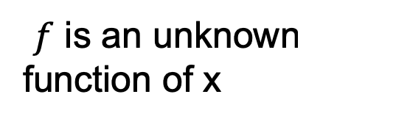
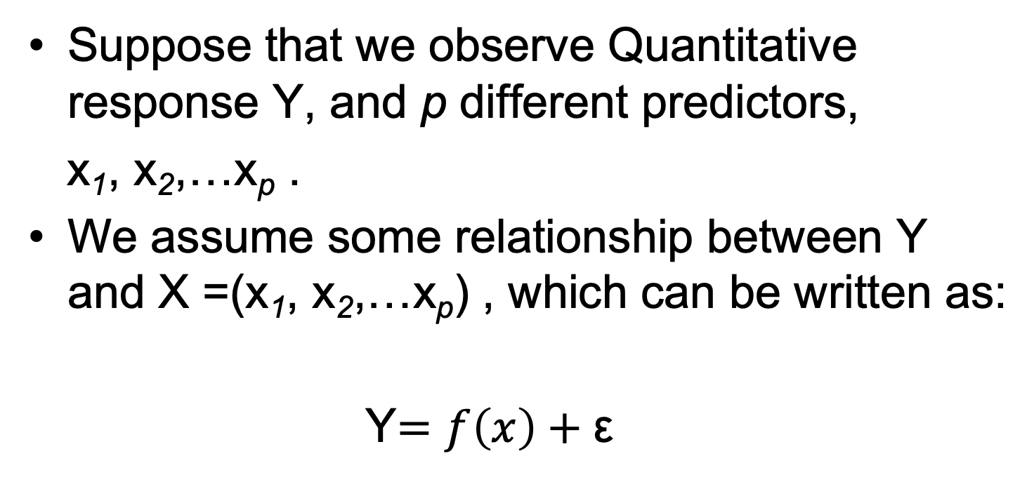
Suppose that we observe Quantitative response Y, and p different predictors,
x₁, x₂,…x_{p} .
We assume some relationship between Y and X =(x₁, x₂,…x_{p}) , which can be written as:
Y$=f\left(x\right)+$ε
$f$ is an unknown function of x
random error term, which is independent of x

Slide 12
Correlation
One measure of the strength of the association between two numerical variables is correlation.
Correlation describes the strength of the linear association between two variables.
Correlation coefficient is between -1 and +1
-1 indicates a perfect negative linear association and +1 indicates a perfect positive linear association. The correlation coefficient of 0, indicates that there is no linear relationship in the two variables. -0.1 and +0.1, indicates no linear relationship or a very weak linear relationship
Correlation coefficient is sensitive to outliers.
Correlation coefficient is unitless.
Reference(s): https://www.investopedia.com/terms/c/correlationcoefficient.asp
https://www.investopedia.com/ask/answers/032515/what-does-it-mean-if-correlation-coefficient-positive-negative-or-zero.asp
Notes:
https://www.investopedia.com/ask/answers/032515/what-does-it-mean-if-correlation-coefficient-positive-negative-or-zero.asp

Slide 13
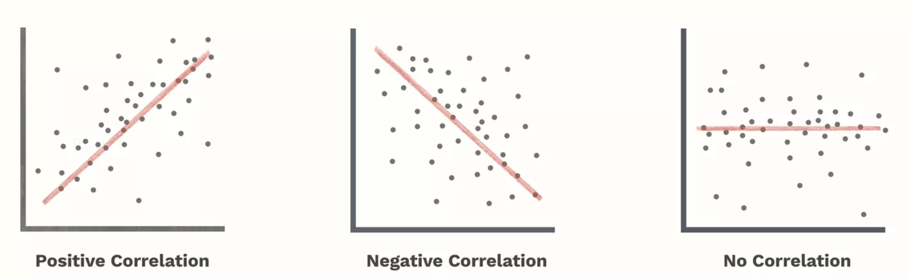
Correlation…
Image/Photo Credit: https://www.investopedia.com/ask/answers/032515/what-does-it-mean-if-correlation-coefficient-positive-negative-or-zero.asp
Reference(s): https://www.investopedia.com/terms/c/correlationcoefficient.asp
https://www.investopedia.com/ask/answers/032515/what-does-it-mean-if-correlation-coefficient-positive-negative-or-zero.asp

Slide 14
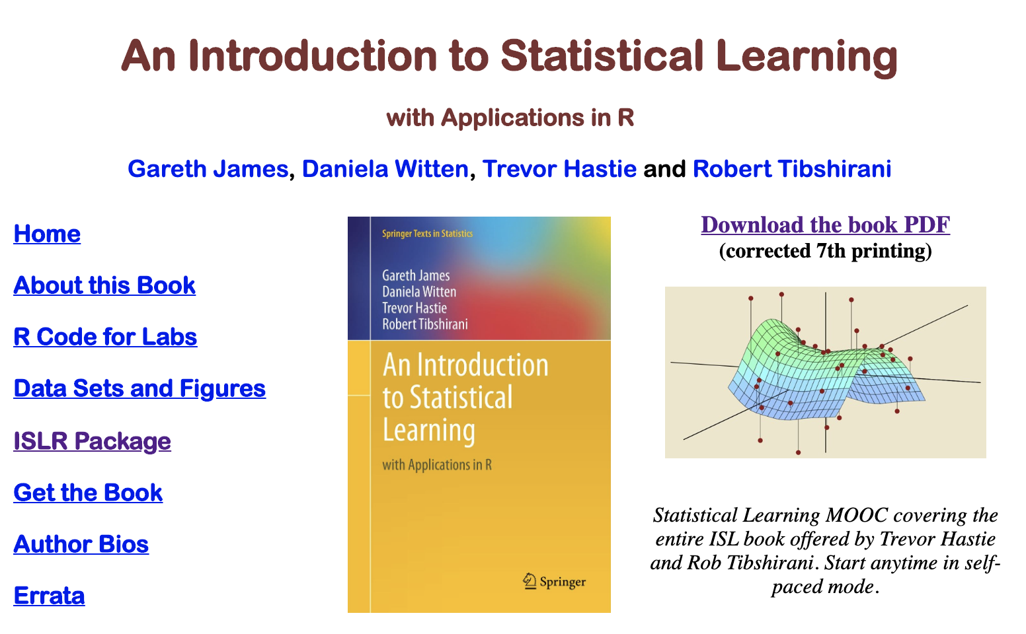
Textbook
Introduction to Statistical Learning with Applications in R ~ 7th Edition
http://faculty.marshall.usc.edu/gareth-james/ISL/
Notes:
http://faculty.marshall.usc.edu/gareth-james/ISL/

Slide 15
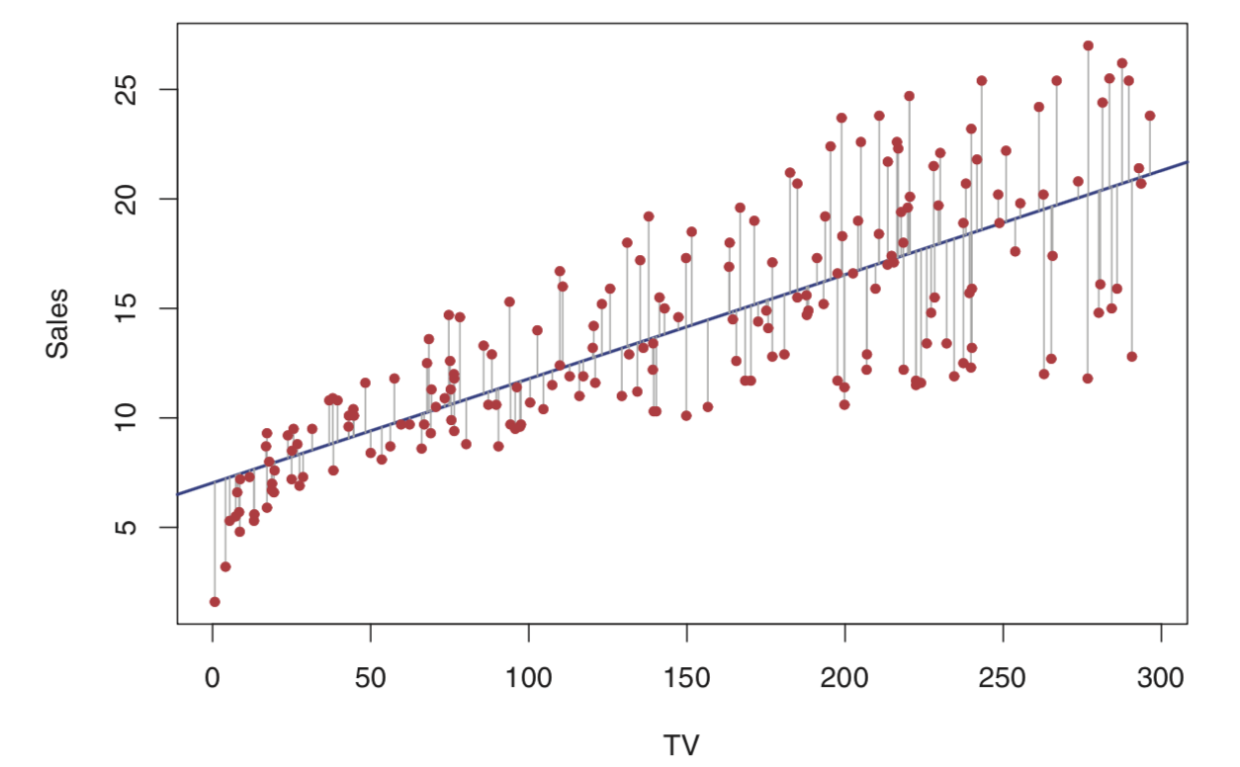
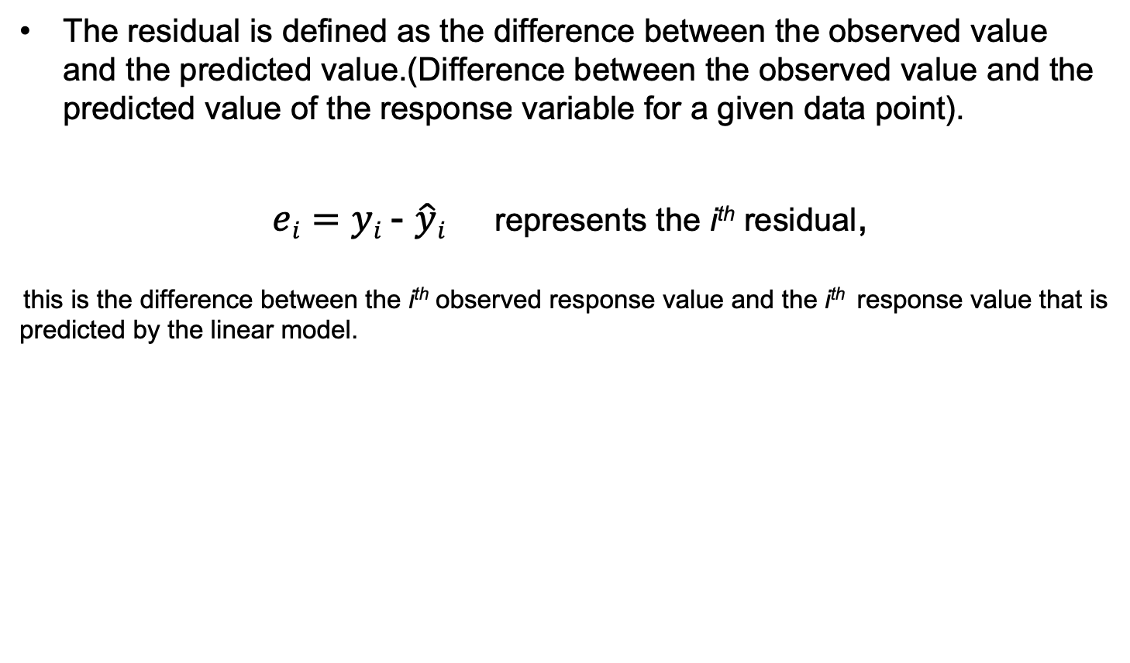
Residuals …
The residual is defined as the difference between the observed value and the predicted value.(Difference between the observed value and the predicted value of the response variable for a given data point).
$ei=yi$- $\hat{y}i$ represents the i^{th} residual,
this is the difference between the i^{th} observed response value and the i^{th} response value that is predicted by the linear model.
Image Credit: Introduction to Statistical Learning with Applications in R, 7th Edition, Chapter 3 – Linear Regression
Reference: Introduction to Statistical Learning with Applications in R, 7th Edition, Chapter 3 - Linear Regression

Slide 16
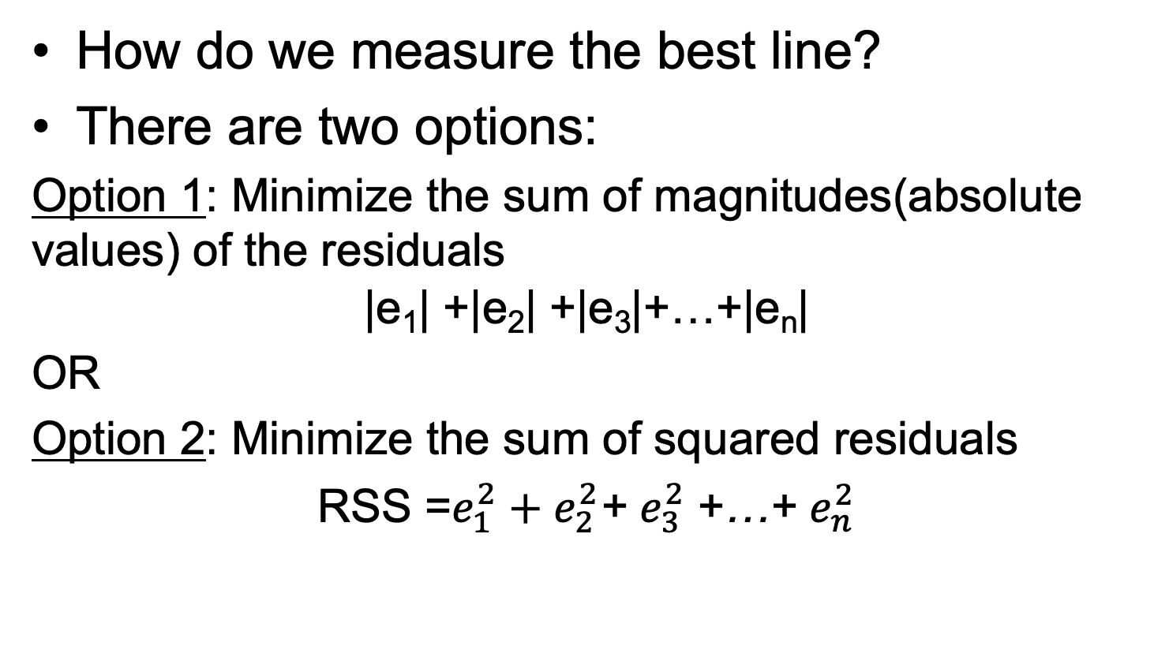

Best line?
How do we measure the best line?
There are two options:
Option 1: Minimize the sum of magnitudes(absolute values) of the residuals
$$\text{|}\text{e}\text{1}\text{| +|}\text{e}\text{2}\text{| +|}\text{e}\text{3}\text{|+…+|}\text{en}\text{|}$$
OR
Option 2: Minimize the sum of squared residuals
RSS =$e_{1}^{2}+e_{2}^{2}$+ $e_{3}^{2}$+…+ $e_{n}^{2}$
$ei=yi$- $\hat{y}i$ represents the i^{th} residual
Homework: read Chapter 3 of Introduction to Statistical Learning with Applications in R, 7th Edition
Reference: Introduction to Statistical Learning with Applications in R, 7th Edition, Chapter 3 - Linear Regression
Notes:
http://faculty.marshall.usc.edu/gareth-james/ISL/

Slide 17
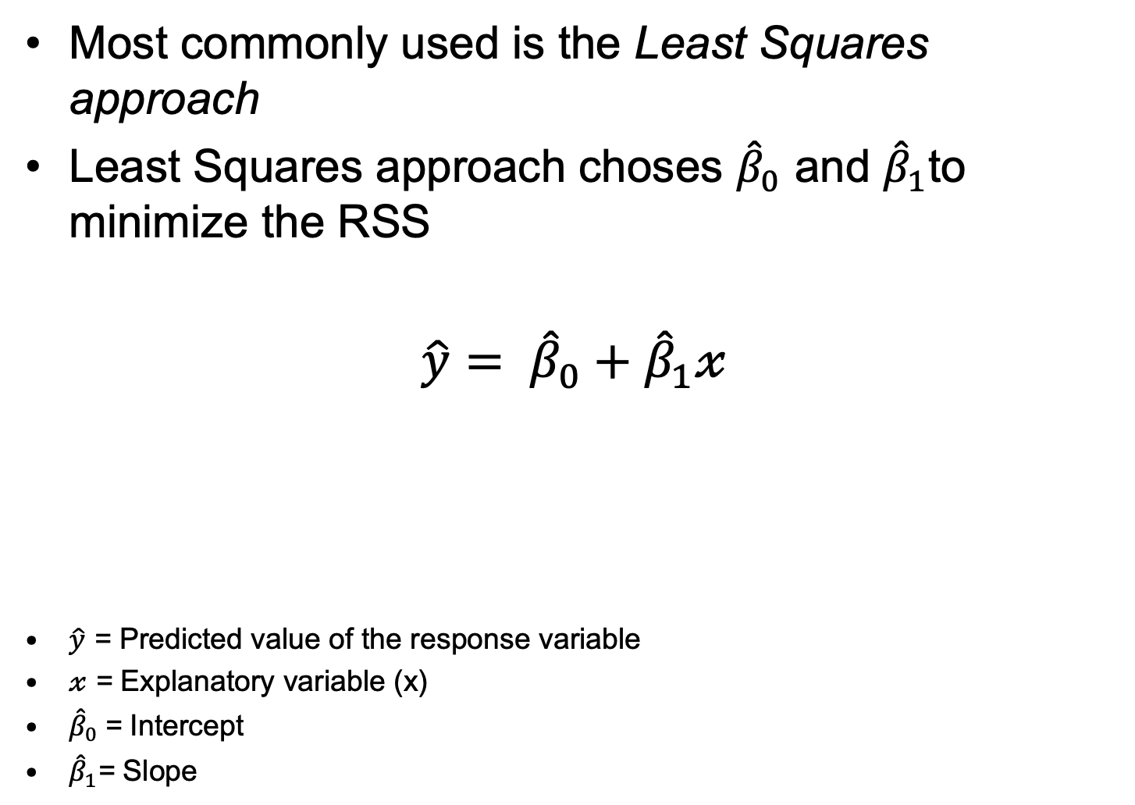
Least Squares Line
Most commonly used is the Least Squares approach
Least Squares approach choses ${\hat{β}}_{0}$ and ${\hat{β}}_{1}$to minimize the RSS
$$\hat{y}= {\hat{β}}_{0}+{\hat{β}}_{1}𝓍$$
$\hat{y}$ = Predicted value of the response variable
$𝓍$ = Explanatory variable (x)
${\hat{β}}_{0}$= Intercept
${\hat{β}}_{1}$= Slope
Explanatory variable
Predicted response
Intercept
Slope
Reference: Introduction to Statistical Learning with Applications in R, 7th Edition, Chapter 3 - Linear Regression

Slide 18
Outliers in Regression
How does an outlier influence the Least Square line?
In general, outliers are the points that fall away from the cloud of points.
Two types –
Leverage Points : Outliers that fall horizontally away from the center of the cloud of points but don't influence the slope of the regression line are called leverage points.
Influential Points : Outliers that actually influence the slope of the regression line are called influential points.

Slide 19
regression…

Slide 20
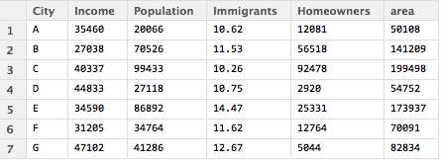
Linear basis and least-squares constraints
> multivariate <- read.csv("~/Documents/teaching/DataAnalytics/data/multivariate.csv")
> attach(multivariate)
> mm<-lm(Homeowners~Immigrant)
> mm
Call:
lm(formula = Homeowners ~ Immigrants)
Coefficients:
(Intercept) Immigrants
107495 -6657
dependent variable
independent variable
Notes:
“mm” here is a R-Object
What can you say about the immigrant column?
Immigrants column is percentage value -- 10.62% of the population

Slide 21
Multivariate.csv dataset
Dataset “multivariate.csv” is available at: http://aquarius.tw.rpi.edu/html/DA/
# Multivariate Regression
multivariate <-read.csv("~/Downloads/multivariate.csv")
head(multivariate)
attach(multivariate)
help(lm)
mm <-lm(Homeowners~Immigrant)
mm # mm here is a R object.
summary(mm)$coef # The output above shows the estimate of the regression beta coefficients (column Estimate) and
# their significance levels (column Pr(>|t|).
# The intercept is 107494.898 and the coefficient of Immigrant variable is -6656.839.
# The estimated regression equation can be written as follow:
# Homeowners = 107494.898 + (-6656.839)*Immigrant
# We can rewrite it as:
# Homeowners = 107494.898 - 6656.839*Immigrant.

Slide 22
plot(Homeowners~Immigrant)
help(abline)
abline(mm)
abline(mm,col=2,lwd=3)
# Using this formula, for each new value in Immigrant, you can predict the value for Homeowners.
# As an example:
# For Immigrant value = 0, we will get: Homeowners = 107494.898 - 6656.839*0 = 107494.898
# for Immigrant value = 20, we will get: Homeowners = 107494.898 - 6656.839*20 = -25641.88
# Predictions can be easily made using the R function predict().
# In the following example, we predict Homeowners for two Immigrant values: 0 and 20.
# you can pass the 0 and 20 values as a concatenated list for Immigrants as follows:
newImmigrantdata <- data.frame(Immigrant = c(0, 20))
mm %>% predict(newImmigrantdata)
abline(mm)
abline(mm,col=3,lwd=3) # line color = green, line width = 3
attributes(mm)
mm$coefficients

Slide 23
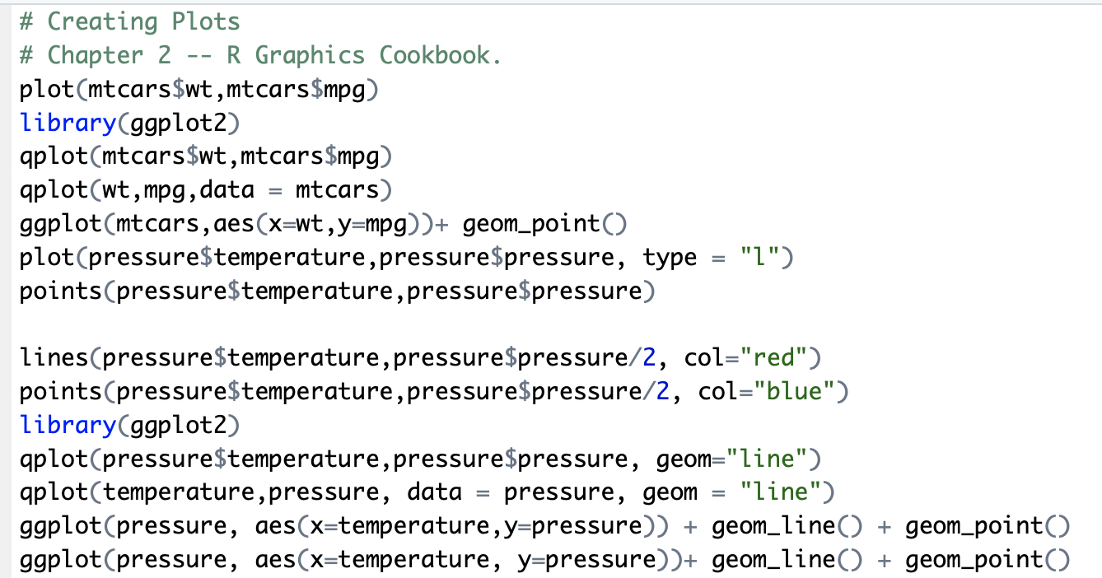
In-Class Work: ggplot examples

Slide 24
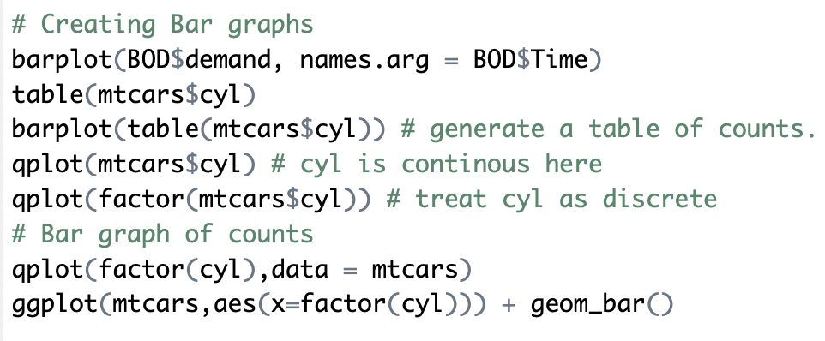
Creating Bar graphs

Slide 25
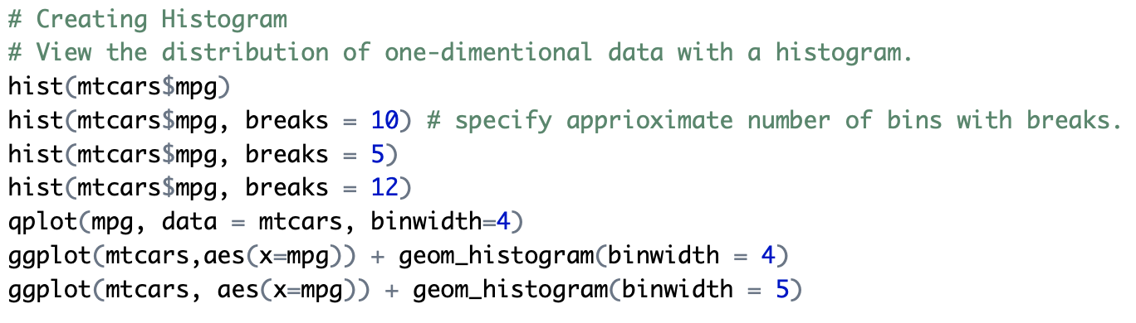
Creating Histograms using ggplot

Slide 26
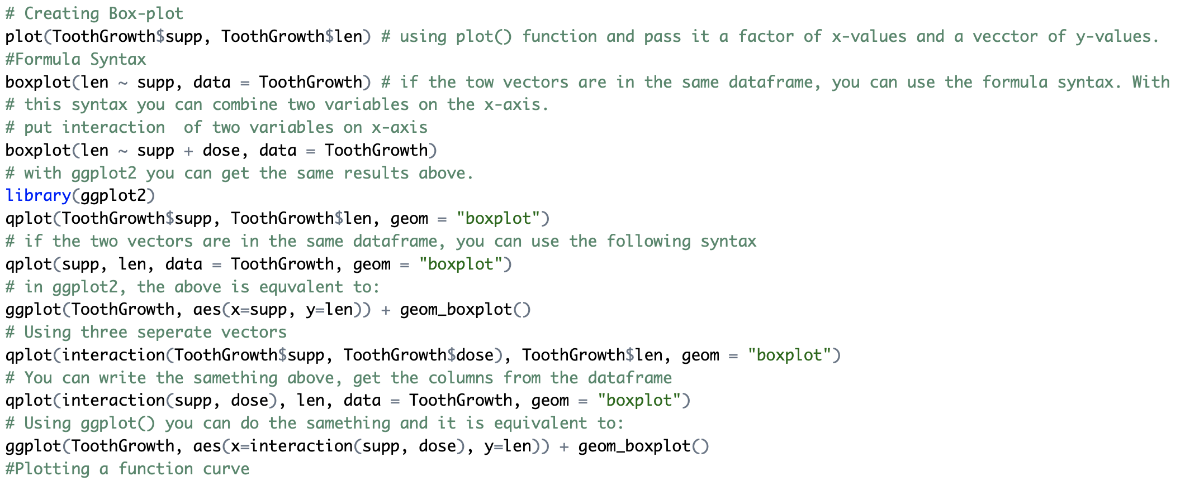
Creating Box-plots using ggplot

Slide 27
visualization exercise
Additional ggplot2 library examples are available on LMS. Please see the “visualization exercise: ggplot and bar graphs” R code snippet on LMS
After you finish the visualization exersize, make sure to push your code to github.

Slide 28
Push your Lab1_part2 code to your Github repository.
Share your GitHub repo URL with the TA if you have not shared it.
Project dataset search: This is a reminder for you to look/search for the datasets that you will be working for the class project.
Read: Chapter 3 – Introduction to Statistical Learning with Applications in R, 7th Edition

